Slide 1

Author: Ayur Patel
Domain: Data Analytics
Aim: Using Power BI to conduct a comprehensive analysis of Indian agriculture
Description: The following project is a part of MENTORNESS Data Analyst Internship which will help to develop data analysis skills in a practical context. By using various visualizations, filters and modelling features. So, herby creating a PPT presentation which includes all the findings and statistics related to the dataset.
LinkedIn: https://www.linkedin.com/in/ayur-patel/

Slide 2
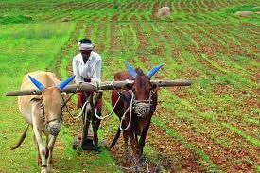
Project 2: Indian Agriculture Analysis
Problem Statement:
This internship project aims to conduct a comprehensive analysis of Indian agriculture, focusing on district-wise and year-wise data. The dataset provides detailed information on various crops, their areas, production, and yields across different districts and years. The goal is to leverage Power BI to create interactive visualizations that uncover trends, patterns, and disparities in agricultural practices, enabling stakeholders to make informed decisions for sustainable farming and resource allocation.

Slide 3
Project Objectives:
Data Exploration: Explore the dataset to understand the distribution of agricultural variables across districts and years.
Crop-specific Analysis: Analyze the trends in the cultivation of major crops, including rice, wheat, and pulses, focusing on changes in area, production, and yield.
Regional Disparities: Identify disparities and variations in agricultural practices and outcomes across different districts and states.
Seasonal Patterns: Explore seasonal patterns in crop cultivation, considering kharif and rabi seasons.
Impact of External Factors: Investigate the impact of external factors like weather conditions on crop performance.
Fruits and Vegetables Analysis: Analyze the cultivation trends of fruits, vegetables, and their overall contribution to agricultural practices.
Sustainable Farming Insights: Derive insights that can contribute to promoting sustainable farming practices and optimizing resource allocation.

Slide 4
Dataset Description:
The dataset encompasses a wide range of agricultural variables, including crop areas, production quantities, and yields for different crops such as rice, wheat, sorghum, millets, pulses, oilseeds, sugarcane, and more.
Deliverables:
Interactive Power BI dashboards providing insights into year-wise and district-wise agricultural patterns.
Visualizations depicting trends in major crops and their variations over time.
Reports on regional disparities, seasonal patterns, and the impact of external factors.
Recommendations for policymakers and stakeholders in the agriculture sector.
This project provides interns with an opportunity to gain hands-on experience in agricultural data analysis and visualization using Power BI, contributing valuable insights to enhance agricultural practices and decision-making in India

Slide 5
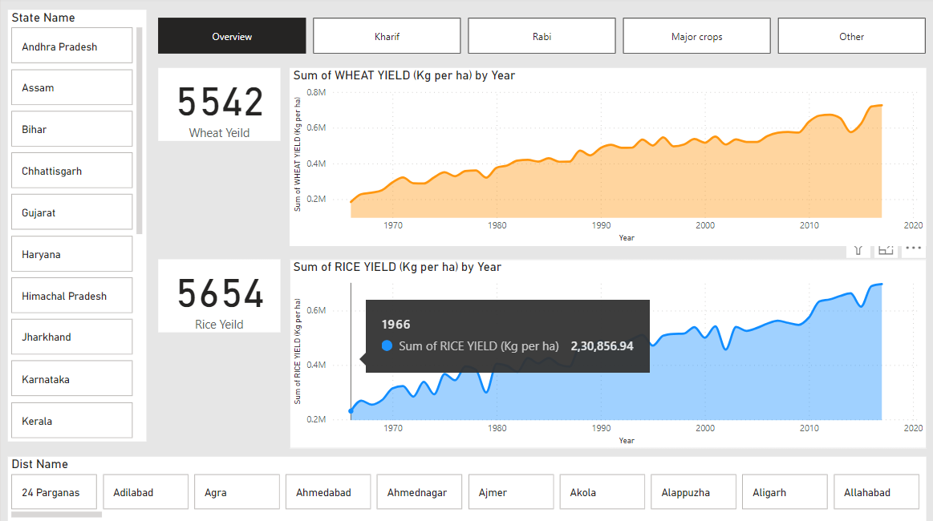

Slide 6
Description:
The above slide gives us an idea of one of the major crops in India, wheat and rice. One could easily get the yield of wheat and rice of a particular region of their choice which involves the state and their respective districts. The card shows us the yield count and the area chart gives us the trend that yield is increasing yearly.
Features used:
Advanced slicer
Area Chart
Card
Measure
Page navigation(buttons)

Slide 7
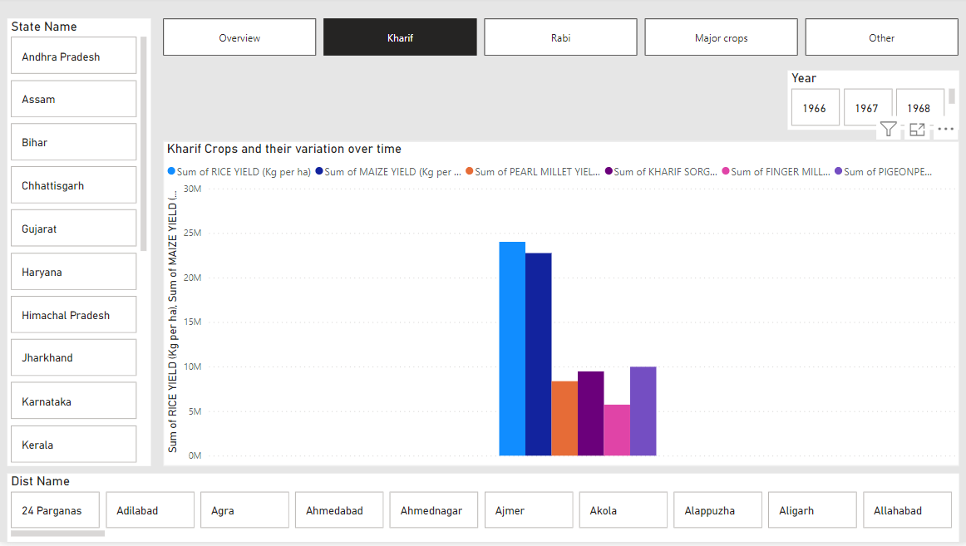

Slide 8
Description:
The above slide gives us an idea of kharif crops which are particularly sown in the season of monsoon and particularly involves more water. The crops which we included are rice, maize, pearl millet, finger millet, pigeon pea and kharif sorghum. The Clustered column Chart clearly shows that rice has the highest overall yield whereas finger millet has the lowest overall yield. We can also select the state, district and year according to the need and view the statistics.
Features used:
Advanced slicer
Clustered column Chart
Card
Measure
Page navigation(buttons)

Slide 9
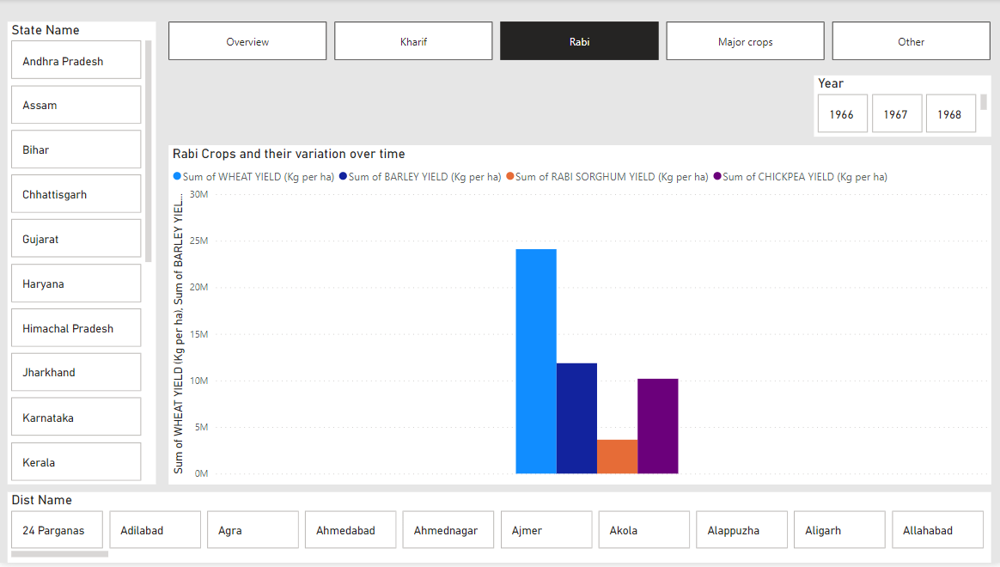

Slide 10
Description:
The above slide gives us an idea of rabi crops which are particularly sown after the monsoon and involves less water. The crops which we included are wheat, barley, chickpea and rabi sorghum. The Clustered column Chart clearly shows that wheat has the highest overall yield whereas rabi sorghum has the lowest overall yield. We can also select the state, district and year according to the need and view the statistics.
Features used:
Advanced slicer
Clustered column Chart
Card
Measure
Page navigation(buttons)

Slide 11
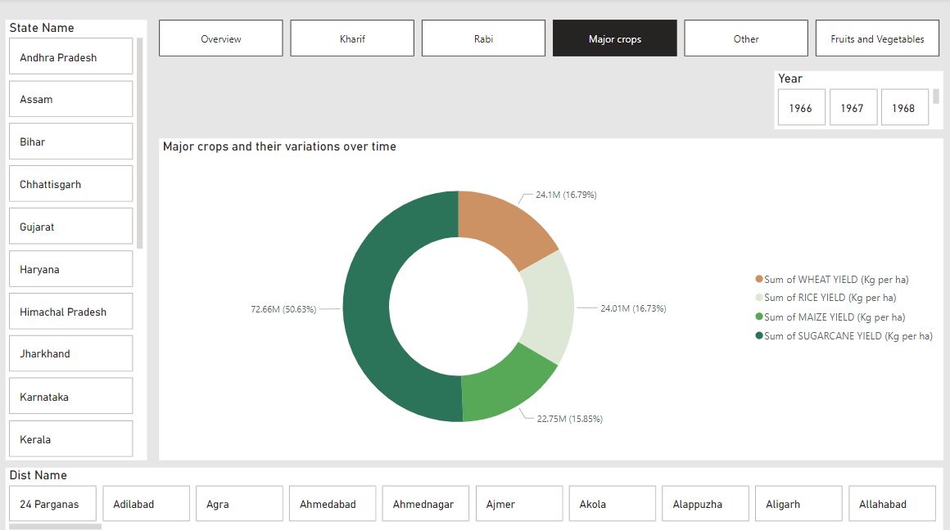

Slide 12
Description:
The above slide gives us an idea of major crops which includes wheat, rice, maize and sugarcane. These crops have the highest consumption rate. The Donut Chart clearly shows that sugarcane has the highest overall yield followed by wheat and rice. We can also select the state, district and year according to the need and view the statistics.
Features used:
Advanced slicer
Donut Chart
Card
Measure
Page navigation(buttons)

Slide 13
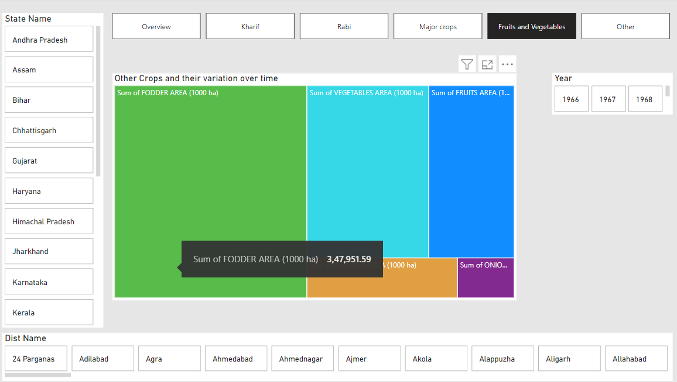

Slide 14
Description:
The above slide gives us an idea of area covered by fruits and vegetables along with fodder. With the help of tree map we can clearly see that fodder covers the maximum area followed by vegetables and fruits. The area covered by the onion is the least. We can also select the state, district and year according to the need and view the statistics.
Features used:
Advanced slicer
Tree Map
Card
Measure
Page navigation(buttons)

Slide 15
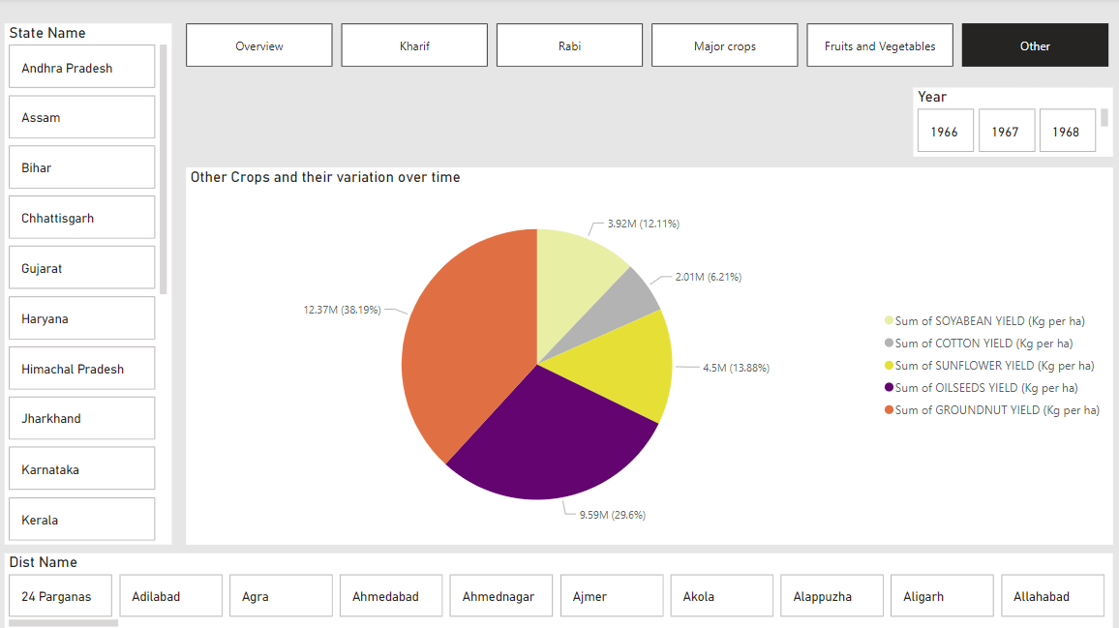

Slide 16
Description:
The above slide gives us an idea of other crops which includes soyabean, cotton, sunflower, oilseed and groundnut. These are also referred as edible crops. The Pie Chart clearly shows that groundnut has the highest overall yield followed by oilseeds and sunflower. We can also select the state, district and year according to the need and view the statistics.
Features used:
Advanced slicer
Pie Chart
Card
Measure
Page navigation(buttons)

Slide 17
Here are some recommendations for policymakers and stakeholders in the agriculture sector:
1. Investment in Sustainable Practices: Encourage investment in sustainable agricultural practices such as organic farming, agroforestry, and precision agriculture. This includes providing financial incentives, grants, and subsidies to farmers adopting these practices.
2. Technology Adoption: Promote the adoption of modern agricultural technologies such as precision farming, IoT devices, drones, and genetic engineering to improve productivity, reduce resource usage, and mitigate environmental impacts.
3. Education and Training: Provide training programs and educational resources to farmers on sustainable farming practices, modern technologies, and efficient resource management techniques. This can help increase adoption rates and improve overall productivity.
4. Diversification: Encourage farmers to diversify their crops and livestock to reduce the risk of crop failure due to climate change, pests, or diseases. This could involve promoting the cultivation of climate-resilient crops and the integration of livestock into crop production systems.

Slide 18
5. Water Management: Implement water management strategies such as drip irrigation, rainwater harvesting, and water recycling to conserve water resources and improve water efficiency in agriculture.
6. Support for Smallholder Farmers: Provide support and resources for smallholder farmers, including access to credit, market information, and infrastructure improvements. This can help enhance their productivity and livelihoods while also promoting inclusive growth in the agricultural sector.
7. Market Access: Facilitate access to domestic and international markets for farmers, including improving transportation infrastructure, reducing trade barriers, and promoting fair trade practices. This can help increase farmers' incomes and stimulate economic growth in rural areas.
8. Climate Resilience: Develop and implement climate adaptation strategies for agriculture, including the breeding of drought-resistant crops, the adoption of climate-smart agricultural practices, and the promotion of agroecological approaches that enhance resilience to extreme weather events.

Slide 19
9. Policy Coherence: Ensure coherence and coordination across different policy areas relevant to agriculture, including environmental protection, rural development, trade, and food security. This can help avoid conflicting policies and maximize the synergies between different policy objectives.
10. Research and Innovation: Invest in agricultural research and innovation to develop new technologies, practices, and crop varieties that can address emerging challenges such as climate change, pests, and diseases. This could involve collaboration between government agencies, research institutions, and private sector stakeholders.
By implementing these recommendations, policymakers and stakeholders can promote sustainable agriculture, enhance food security, and support the livelihoods of farmers while also addressing environmental challenges and promoting economic development in rural areas.

Slide 20

THANKS

